Slide 1


EcE 659 PROJECT PRESENTATION
GROUP 28
DEEP JARIWALA – 20909290
SAYONEE PARIKH – 20919577
VASU PATEL – 20891386

Slide 2
SPECTRUM SENSING USING CNN BASED DEEP LEARNING

Slide 3
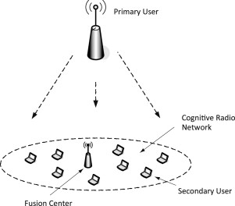
COGNITIVE RADIO AND SPECTRUM SENSING
Cognitive sensor network is a network that can dynamically alter its topology and/or operational parameters to respond to the needs of a particular user while enforcing operating and regulatory policies and optimizing overall network performance.
Cognitive radio permits unlicensed gadgets to artfully use the authorized range, for example, TV broadcast groups, has been proposed as an expected technique to address the spectrum shortage issues.

Slide 4
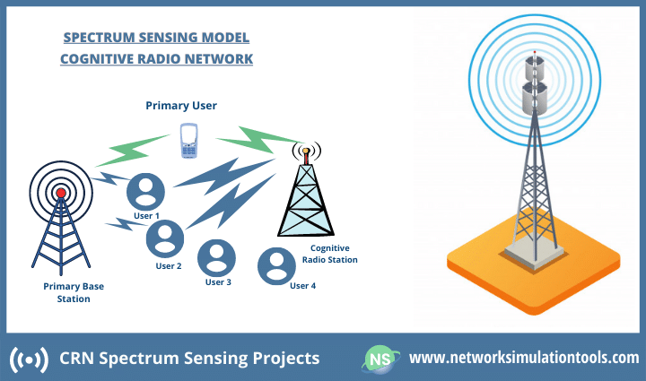
COGNITIVE RADIO AND SPECTRUM SENSING
Spectrum sensing is the process of periodically monitoring a specific frequency band, aiming to identify presence or absence of primary users.
This approach has been a potential proposed method to address the shortage of spectrum. It is a technology that allows secondary users (SUs) to access the licensed band of primary users (PU) when the primary user is not utilizing it. Few challenges could be encountered for the successful practical deployment of cognitive radio systems.

Slide 5
PROBLEM STATEMENT AND SOLUTION
The inefficient usage of the existing spectrum can be improved by building an intelligent allocation system known as cognitive radios (CR) that provides opportunistic access to the licensed bands without interfering with the primary users (PU). Cognitive radio is a network that consists of primary and secondary users (SUs). The PUs are licensed users and hence have exclusive rights to access the radio spectrum. In contrast, the SUs/cognitive users are the unlicensed users that can opportunistically access the free spectrum bands without causing interference to PUs.
The aim is to build a classifier that can detect the status of the spectrum in terms of its occupancy.
In this project, we present spectrum sensing as a classification problem and propose the development of a deep learning-based spectrum sensing detector. The method uses the power spectrum of the signal as the input of the CNN/LSTM based model and uses various types of signal data and noise data to train the network. In our approach, spectrum sensing is expressed as a binary hypothesis problem.

Slide 6
DATASET DESCRIPTION
The dataset used for building the model is labelled as ”DEEPSIG DATASET: RADIOML 2016.04.C”.
The dataset consists of 1,61,800 rows categorized in three columns: SNR, modulation type, and data of the signal.
The dataset includes a comprehensive range of SNR values starting from -20dB to +18dB, progressing at an interval of 2dB. Furthermore, the dataset is classified into 11 different types of modulation, of which eight are digital, and three are analog. The modulation type parameters are AM-DSB, AM-SSB, BPSK, CPFSK, GFSK, PAM4, QAM64, QAM16, QPSK, WBFM, and 8PSK. The signal data (complex-valued inputs) for each SNR and modulation type consists of an array of dimensions [2, 128] where the orthogonal synchronously sampled In-phase, and Quadrature (I & Q) samples.
The pre-processing for the dataset is carried to filter out the digital modulation signals. 8PSK, BPSK, GFSK, QAM64, PAM4, QAM16 modulation signals are included in the dataset. CSCG noise is generated based on the I and Q value’s standard deviation to create an equal amount (number of signal data) of random data with a zero mean.
The noise data is added to the signal data and appended with the noise data to double the number of samples. The samples with (noise + signal) are labelled as 1, and those with only noise are labelled as 0.

Slide 7
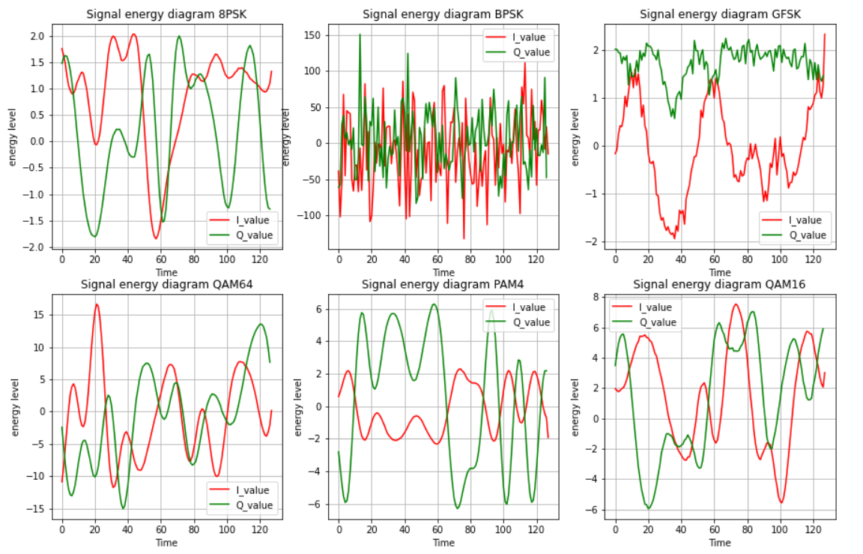
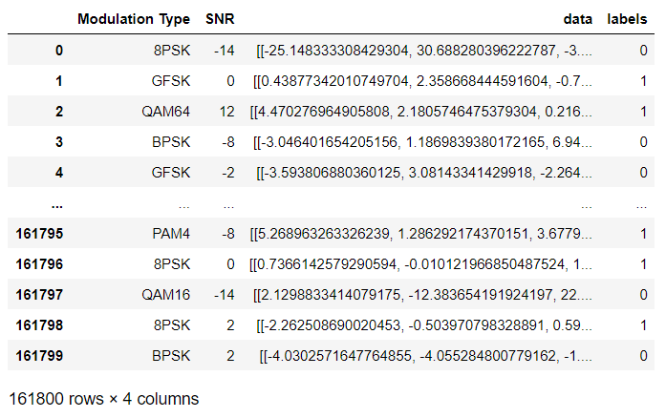
DATASET DESCRIPTION

Slide 8
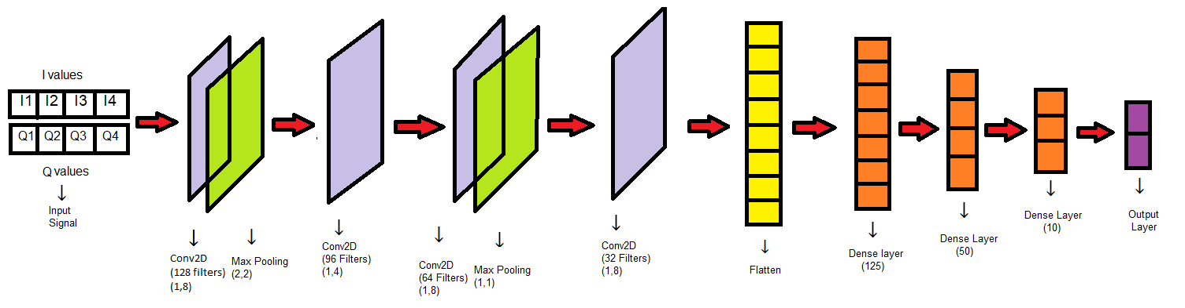
DEEP LEARNING MODEL - NETWORK ARCHITECTURE

Slide 9
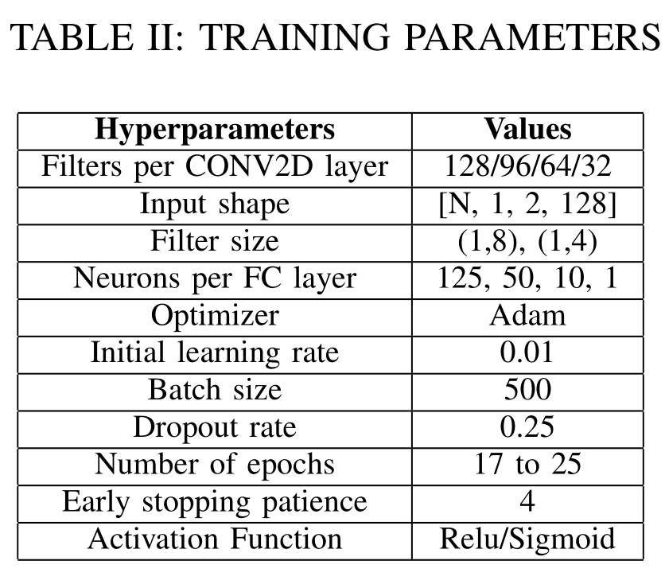
DEEP LEARNING MODEL - TRAINING
The dataset is split into two parts 70% for training and 30% for testing. The training is conducted using the ADAM optimization technique that uses binary cross-entropy as a loss measure. Implementing the model for training and testing takes place on an NVIDIA Cuda enabled GeForce 1080 Ti GPU.
The implementation uses an early stopping call-back method (patience of 4) that measures the validation set’s progress for a number of epochs to reduce overfitting and roll back to the best model. The model was trained over 113260 data samples that achieved an accuracy of 86.11%, with a loss of 0.2463.

Slide 10
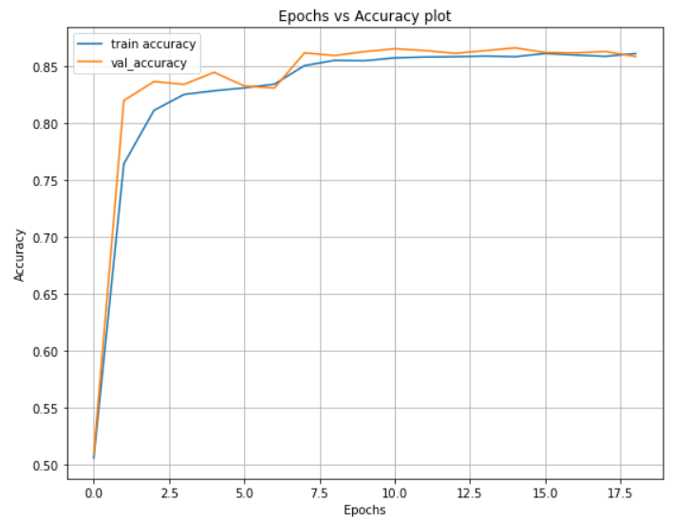
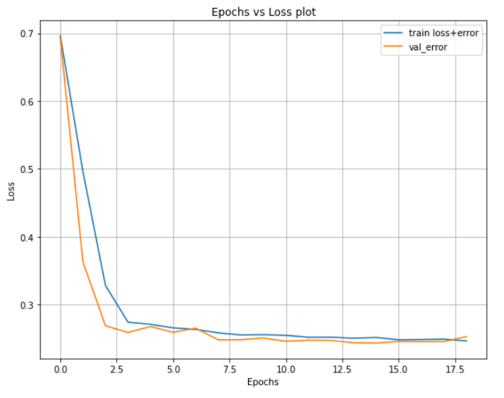
DEEP LEARNING MODEL – VALIDATION & TEST
Validation Details: The validation split for the best model was selected as 0.3. The training results gave the best validation accuracy of 86.61% and a least loss of 0.2432.
Test Details: The test accuracy obtained by the proposed system is 86.59%, with a loss of 0.2478.

Slide 11
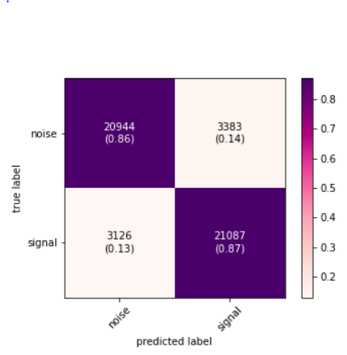
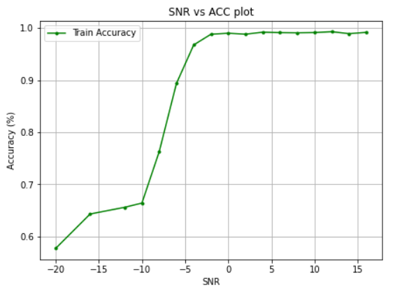
SIMULATION RESULTS
The Fig. 6 shows the overall confusion matrix for the test set for all SNR values. It can be seen that noise vectors are more misclassified compared the signal vectors. Moreover, BPSK and GFSK observes the most misclassification among other modulation type at low SNR values.
The plot shows the variation of test accuracy with different values of SNRs. It can be observed that majority of the SNR values after -4dB has an accuracy over 90% while for the SNR values lower than -4dB observes a poor performance.

Slide 12
THANK YOU

